Slide 2



Advanced AI
Traditional AI
Generative AI
Simple model:
Purpose-built for one use
Foundation model:
More generalized intelligence with many applications
Notes:
Artificial Intelligence
Foundational models transform how we think about AI.
Traditional AI models were great at performing one task – you design and train an AI model for image classification and then another model to predict a sales forecast.
Now Foundational models with billions of parameters trained on an AI supercomputer in Azure are achieving tasks unimaginable just a few short years ago.
AI models are evolving from the single purpose, task driven to take on MULTITUDES of TASKS even in different domains or modalities.
Think about applying a model in domains as different as Medical Research and Law or mixing modalities like audio and video.
It can help us make informed decisions across massive amounts of disparate data and create a whole new breed of application hard to imagine a few years ago.

Slide 3


Advanced AI
Perceive
Abstract
Perceive
Learn
Abstract
Reason
Contextual model
Generative AI
Learn
Reason
Foundation model:
More generalized intelligence with many applications

Slide 4







Applied AI
Enhance Productivity
Augment Cognition
Accelerate Discovery
Capabilities
AI for
Science
AI for
Health
AI for Cybersecurity
AI for Biosecurity
AI for
Missions
AI for
Societal Resilience

Slide 5







Applied AI
Enhanced Productivity
General
Augmented Cognition
Targeted
Accelerated Discovery
Specialized

Slide 6
Applied AI
Enhanced Productivity
Augmented Cognition
Accelerated Discovery
Worker productivity
Analyst assistance
Mission advancement
Content summarization, analysis, & generation
Research, data collection, data extraction
Cybersecurity & information assurance
Communications (internal & external)
Intel analysis & interpretation
Predictive modeling & forecasting
Knowledge supplementation – advisors & chatbots
Insight / hypothesis generation
Administrative, routine tasks
Novel discovery
Whole of mission support
Material science advancements
Developer productivity
Personnel & facilities management
Gaming + Modeling & Simulation
GitHub
Financial understanding
Multi-domain information fusion w/ insights
Training and professional development
Operations based; data driven decision making
Real-time information cycle; Knowledge supplementation – advisors & chatbots
Information fusions across datasets
Anomaly detection
Notes:
Federal opportunity – our single biggest growth opportunity.
Highlight why everyone should care as an employee and shareholder
Ability to increase MW revenue 70% annually 3B -> 5B
Already demonstrated an improvement of 200% increase in MoM growth in Azure
Introduction: “Let’s explore the Federal AI Strategy, which aims to empower every part of the mission with AI.”
Enhanced Productivity:
Worker Productivity: AI aids in summarizing content, enhancing communication, and performing routine tasks.
Developer Productivity: Tools like GitHub streamline development processes.
Augmented Cognition:
Analyst Assistance: AI supports data collection and interpretation, fostering insight generation.
Mission Support: AI enhances personnel management, financial understanding, and professional development.
Accelerated Discovery:
Mission Advancement: AI improves cybersecurity and predictive modeling.
Novel Discovery: AI contributes to material science and multi-domain information fusion.
Conclusion: “This strategy ensures that AI enhances productivity, cognition, and discovery across all mission areas.”

Slide 7


Non-agentic Workflow (zero-shot)
Act as a rulemaking analyst and provide a detailed analysis of the rule below. Think through all aspects and so that I can write a better rule. Return the analysis in markdown format. You must write the analysis in one go, without using backspace.
International Traffic in Arms Regulations: Registration Fees
User Prompt
Start
Finish

Slide 8
Agentic Workflow
Provide an analysis of this rule: International Traffic in Arms Regulations: Registration Fees
Agentic Reasoning
Review the document and suggest an outline for the analysis.
Do you need any web research?
Do you want to access any of our previous rules or analysis?
Step through each element in the outline and write a draft.
Review the draft and consider if it needs revision?
Think
Research
Write
Review
Revise

Slide 9
Reflection

Slide 10
Tool Use

Slide 11
Planning

Slide 12
Multiagent Collaboration

Slide 13
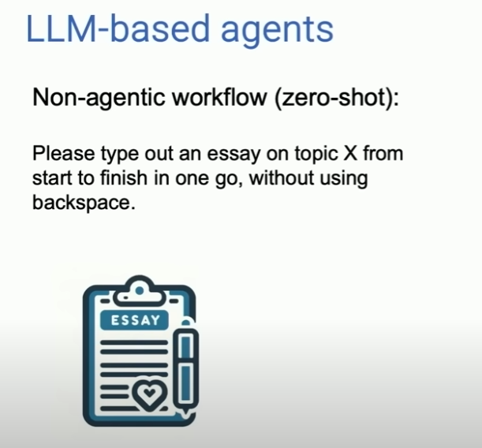
AI Agents

Slide 14
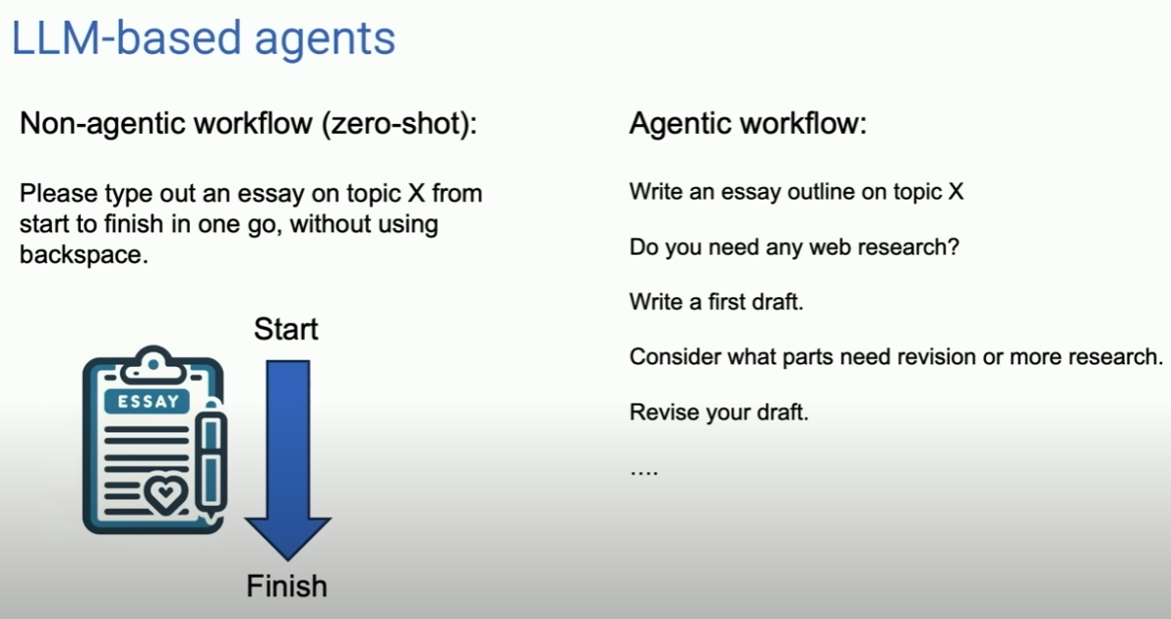

Slide 15
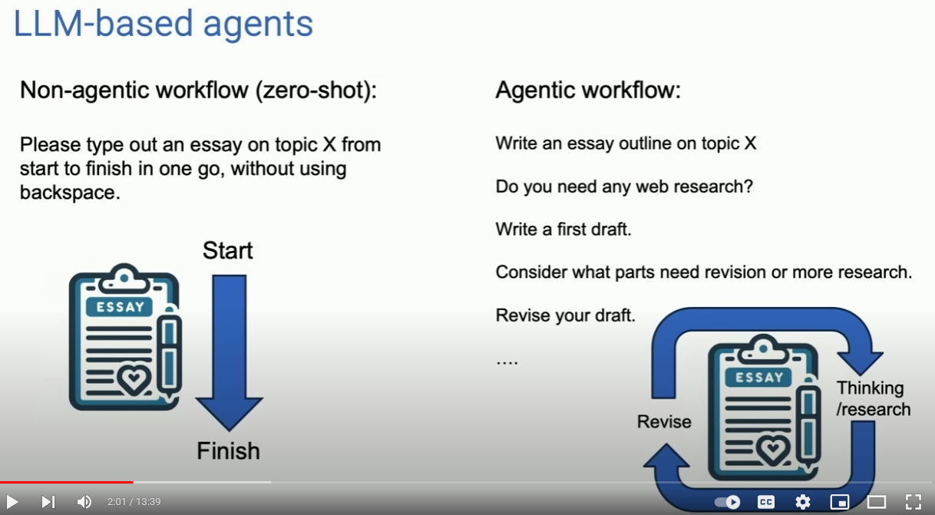

Slide 16
Introducing SAM — A 7B Small Agentic Model that outperforms GPT-3.5 and Orca on reasoning benchmarks | by SuperAGI | Medium
What is Agentic Workflow? Discover How AI Enhances Productivity (masterdai.blog)

Slide 17



3 Waves of AI
FIRST WAVE
Hand crafted knowledge
SECOND WAVE
Statistical learning
THIRD WAVE
Contextual adaptation
Reason over narrowly defined problems
No learning capability
Perceive surrounding world
Lack good reasoning
Understand context, reason and decide

